Slide 1
Few-Shot Learning in Neural Networks (რამდენიმე ნიმუშით სწავლება)
Paata Gogishvili
Doctor of Informatics, professor
paatagog@gmail.com www.youtube.com/playlist?list=PLz3Vid2C88E0phUejA95LbVRJhgJokDpJ
December 14, 2022

Slide 2
Learning of Neural Networks is performed on data.
The more data we have, the more reliably the network can learn.

Slide 3
The amount of data for some popular datasets
MNIST – 70 000
CIFAR10 – 60 000
IMAGENET – 14 000 000
https://www.kaggle.com/datasets

Slide 4

In some cases we do not have enough number of learning samples

Slide 5
There are several workarounds, when we have few data
Data augmentation;
Meta learning.

Slide 6
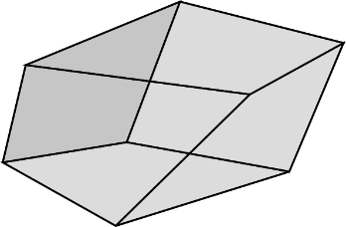
Data Augmentation
(მონაცემთა გამრავალფეროვნება)
Let’s we have the following sample for learning

Slide 7
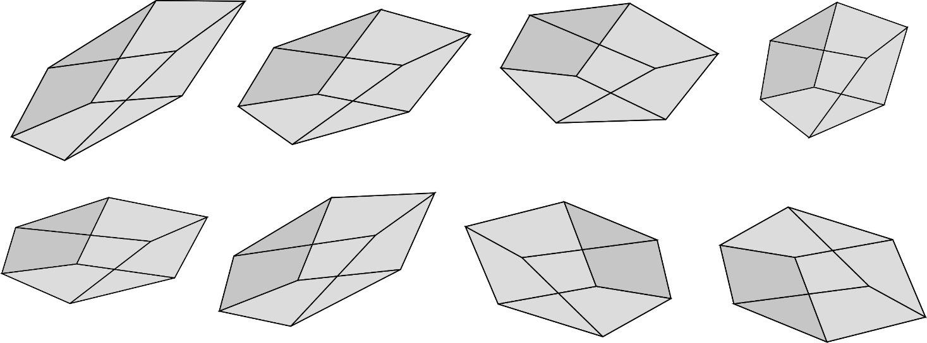
Data Augmentation
(მონაცემთა გამრავალფეროვნება)
Let’s we have the following sample for learning
With simple transformations we can get 100-s of different samples for one sample. This approach drastically increases chance of stable learning.

Slide 8
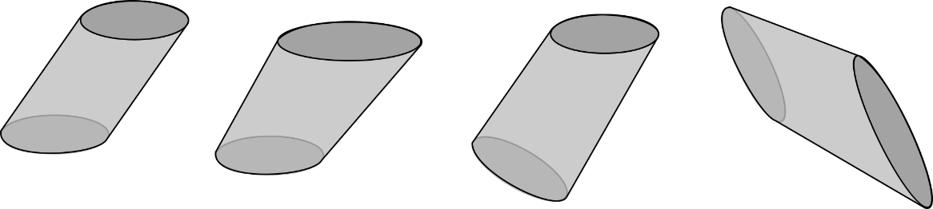
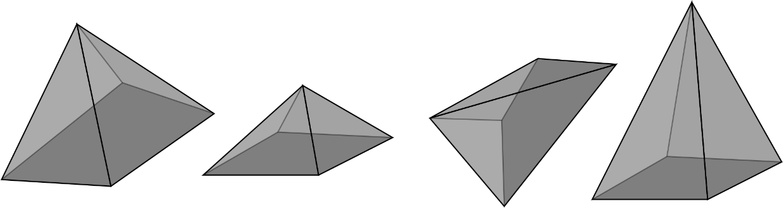
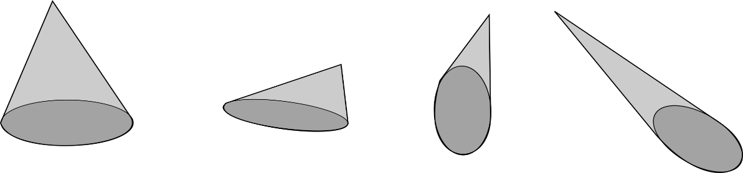
Meta Learning
Suppose we want to train neural network, which will be able to tell difference between the following figures.
Number of classes is K, number of samples per class is N.
N-way K-shot image classification task. When K is small, we have few-shot image classification (or one-shot in the case where K=1)
truncated cone
quadrangular pyramid
cone

Slide 9
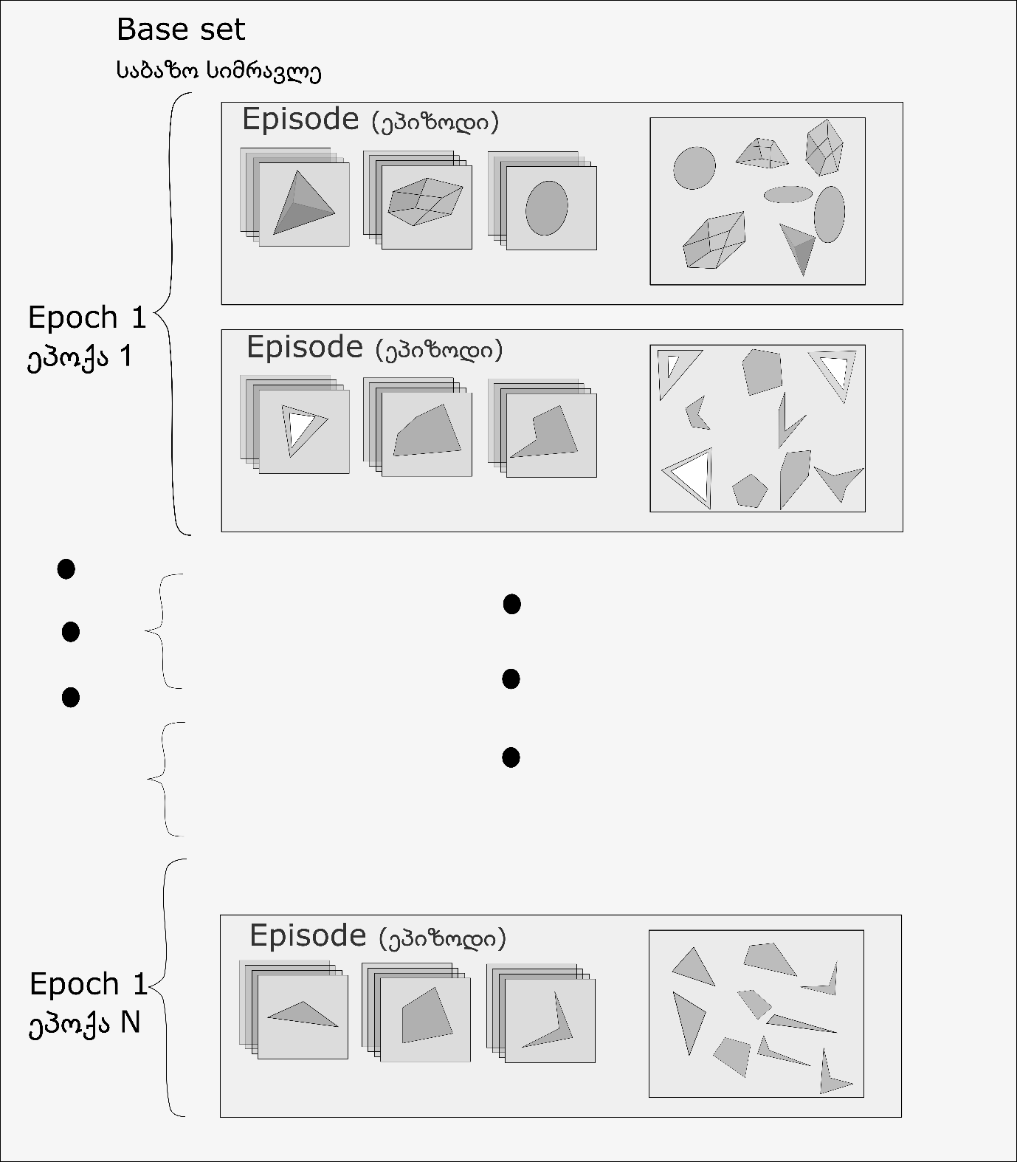
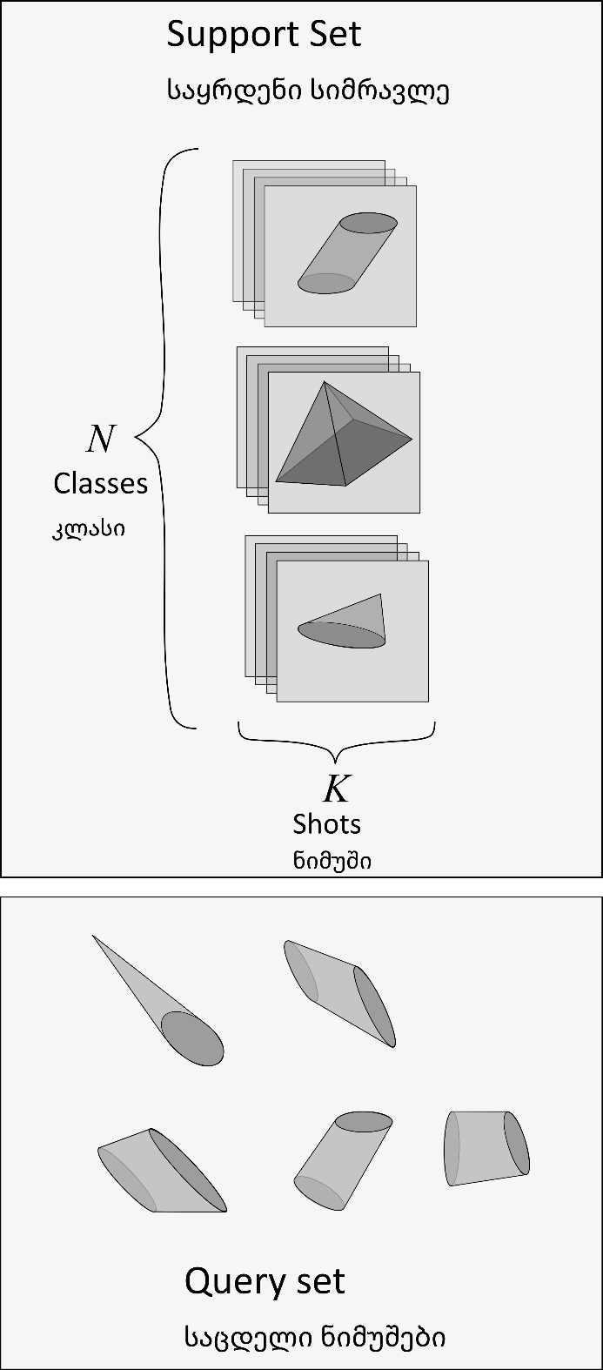
In our case K=3, N=4.

Slide 10
Main advantage of the meta learning algorithm is that it is model agnostic.
It gives us freedom to select or elaborate our own models for episode training.

Slide 11
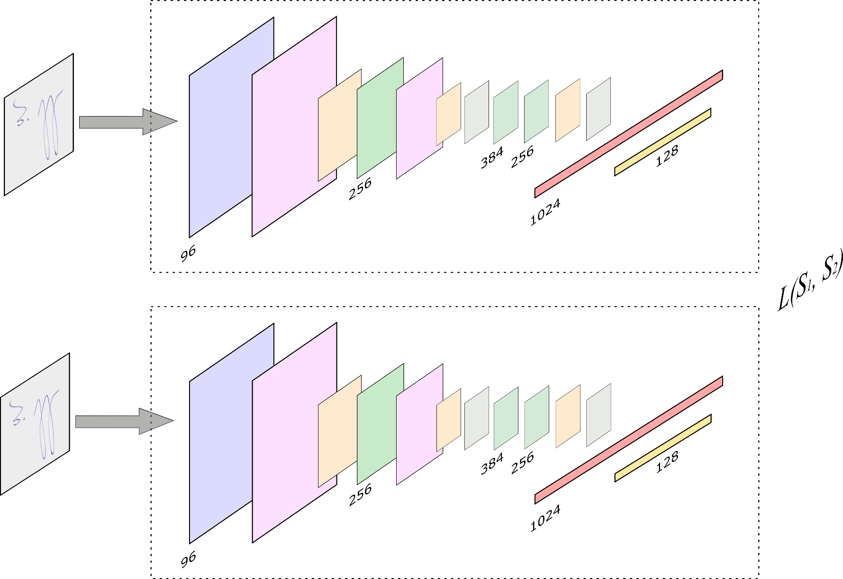
Transfer Learning
https://towardsdatascience.com/a-friendly-introduction-to-siamese-networks-85ab17522942

Slide 12
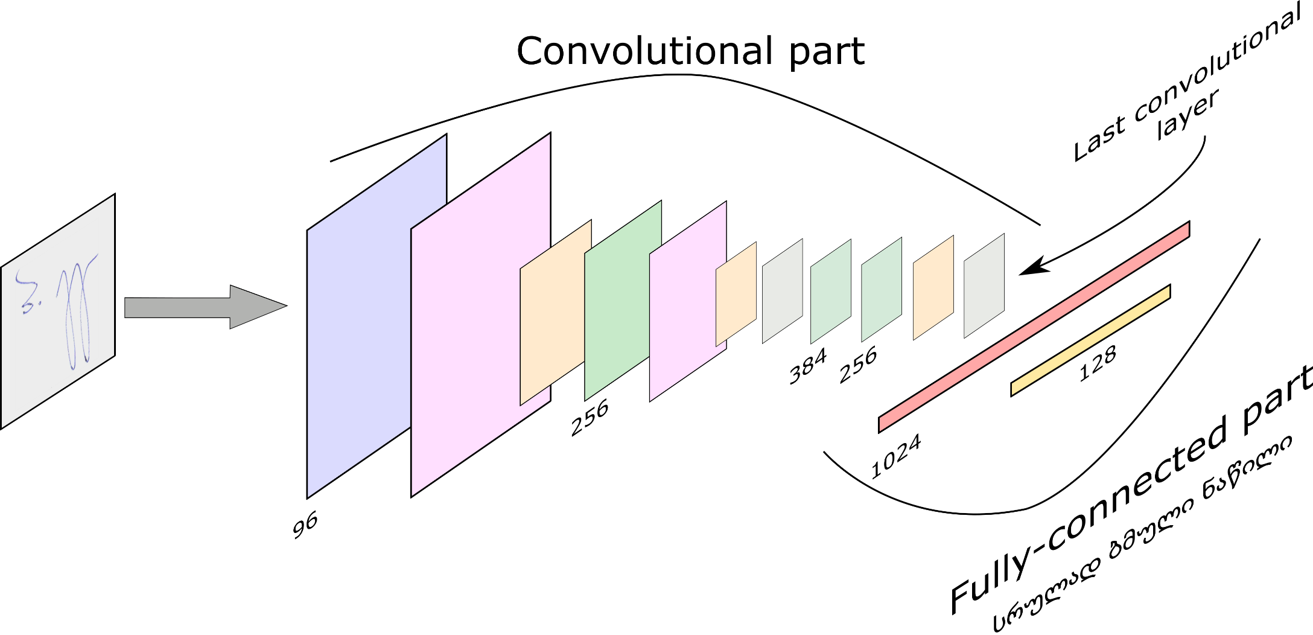
Transfer Learning (ცოდნის გადაცემა)
Model Fine-Tuning (მოდელის დახვეწა)
https://towardsdatascience.com/a-friendly-introduction-to-siamese-networks-85ab17522942

Slide 13
Zero-Shot Learning (უნახავად ცნობა)
Zero-shot methods generally work by associating observed and non-observed classes through some form of auxiliary information, which encodes observable distinguishing properties of objects.
For example, given a set of images of animals to be classified, along with auxiliary textual descriptions of what animals look like, an artificial intelligence model which has been trained to recognize horses, but has never been given a zebra, can still recognize a zebra when it also knows that zebras look like striped horses.

Slide 14
Sources:
https://neptune.ai/blog/understanding-few-shot-learning-in-computer-vision
https://www.sicara.fr/blog-technique/2019-07-30-image-classification-few-shot-meta-learning
Y. Wang, Q. Yao, J. Kwok and L. M. Ni, "Generalizing from a Few Examples: A Survey on Few-Shot Learning," https://arxiv.org/abs/1904.05046
Xiaoxu Li, Xiaochen Yang, Zhanyu Ma, and Jing-Hao Xue
https://arxiv.org/pdf/2105.08149.pdf

Slide 15
Looking Forward To collaborating with you!

